Slide 1
Review Analysis of SOFITEL HOTEL MUMBAI from TRIP ADVISOR
PROJECT 64
Group 1
GS Prathap Reddy
Ruchira Pal
Archana S
Janani M R
Siddiqui Mohammed Atif
Linga Saketh

Slide 2
EXPLORATORY DATA ANALYSIS (EDA) and FEATURE ENGINEERING

Slide 3
Data set details
The data set has 4 columns and 6135rows.
Contains zero missing values.
Consists of categorical/alphanumeric values.
There are no duplicate values.
These are the explanations for variables.
Name (object): Guest names who stayed in the hotel.
Place (object): Places, from where the guest came.
Review Title (object): Title of the reviews given by the guests.
Reviews (object): Review given by the guest.

Slide 4
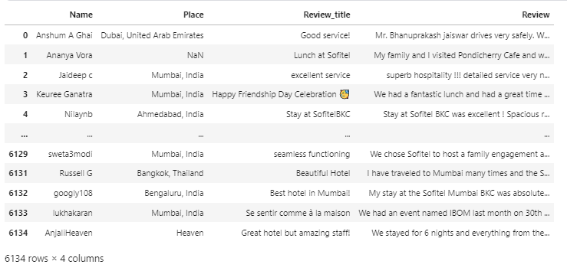

Slide 5
Data Pre-processing steps
Removing punctuations & Whitespaces
Removing stop words
Lemmatization and Tokenization
Top 20 Frequent words
word cloud generation
Top 10 bigrams
Sentimental Analysis

Slide 6
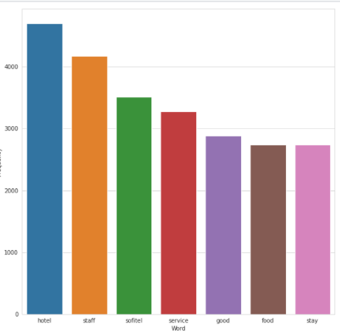
Frequency of most common words in the review

Slide 7
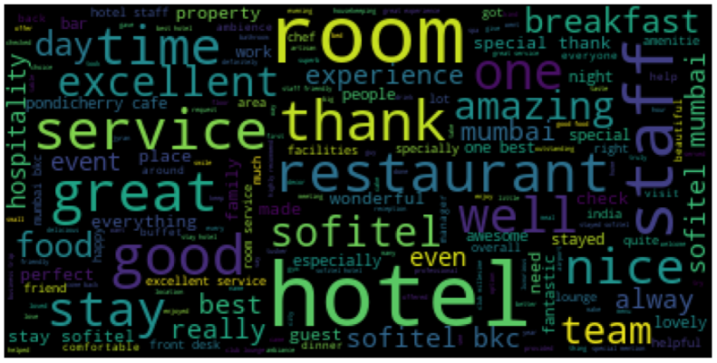
Word Cloud of most common words in the review

Slide 8
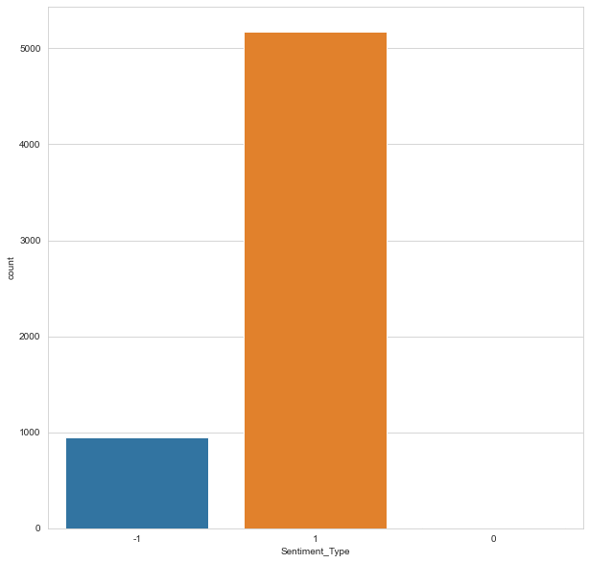
Positive and Negative Sentiment
Analysis where -1 represents negative sentiment and +1 represents positive.

Slide 9
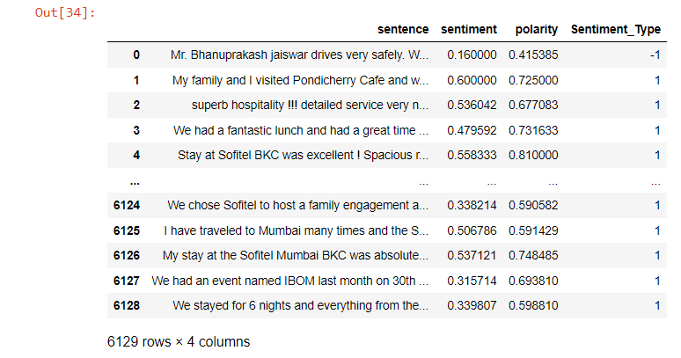

Slide 10
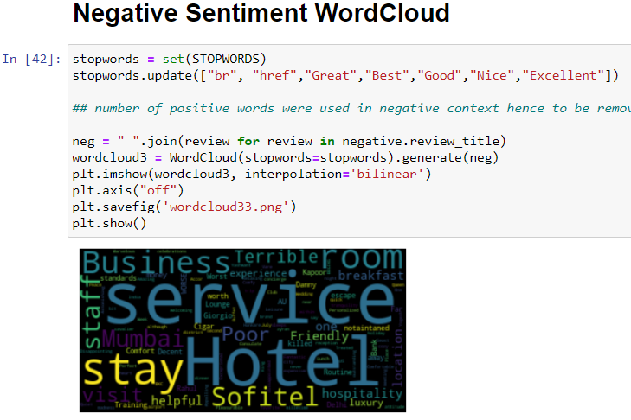
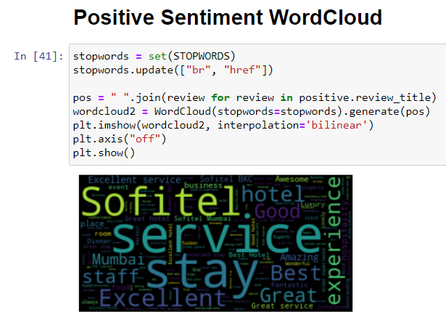
Positive Sentiment wordcloud
Negative Sentiment wordcloud

Slide 11
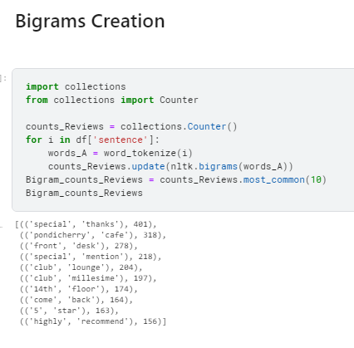
The table represents the top 10 bigrams in the reviews column.

Slide 12
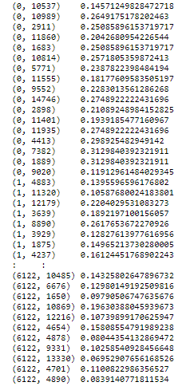
TIIDF Values

Slide 13
MODEL BUILDING

Slide 14
List of Models Created
Following are the models used for Model building in this project:
1)Logistic regression.
2)Decision tree classifier.
3) Random forest classifier.
4) Extra tree Classifier.
5) Support Vector Machine(SVM) Classifier.
6)Neural Networks
7)Bagging classifier method.
8)Linear SVM.
9)Naïve Bayes classifier.
10)XGB Classifier.

Slide 15
MODELS BEFORE SMOTE
Model Used | Category | Precision | Recall | f1-score | Number of errors | Test Accuracy | Train Accuracy
Logistic Regression | Negative | 0.87 | 0.14 | 0.25 | 250 | 0.863 | 0.90
 | Positive | 0.86 | 1.00 | 0.93
Decision Tree Classifier | Negative | 0.31 | 0.32 | 0.32 | 391 | 0.78 | 1.00
 | Positive | 0.87 | 0.87 | 0.87
Random Forest Classifier | Negative | 1.00 | 0.01 | 0.03 | 280 | 0.84 | 1.0
 | Positive | 0.85 | 1.00 | 0.92
Extra tree Classifier | Negative | 0.83 | 0.02 | 0.03 | 280 | 0.84 | 1.0
 | Positive | 0.85 | 1.00 | 0.92
SVM Classifier | Negative | 1.00 | 0.02 | 0.04 | 278 | 0.84 | 0.97
 | Positive | 0.85 | 1.00 | 0.92
Neural Networks | Negative | 0.49 | 0.30 | 0.37 | 288 | 0.84 | 0.99
 | Positive | 0.88 | 0.94 | 0.91
Bagging Classifier | Negative | 0.45 | 0.24 | 0.31 | 300 | 0.83 | 0.99
 | Positive | 0.87 | 0.95 | 0.91
Linear SVC Classifier | Negative | 0.63 | 0.30 | 0.41 | 249 | 0.86 | 0.99
 | Positive | 0.88 | 0.97 | 0.92
Naïve Bayes Classifier | Negative | 0.00 | 0.00 | 0.00 | 284 | 0.84 | 0.84
 | Positive | 0.85 | 1.00 | 0.92
XGB Classifier | Negative | 0.59 | 0.24 | 0.34 | 263 | 0.85 | 0.98
 | Positive | 0.87 | 0.97 | 0.92

Slide 16
MODELS AFTER SMOTE
Model Used | Category | Precision | Recall | f1-score | Number of errors | Test Accuracy | Train Accuracy
Logistic Regression | Negative | 0.49 | 0.52 | 0.51 | 289 | 0.84 | 0.96
 | Positive | 0.91 | 0.90 | 0.91
Decision Tree Classifier | Negative | 0.32 | 0.31 | 0.32 | 390 | 0.78 | 1.0
 | Positive | 0.87 | 0.88 | 0.87
Random Forest Classifier | Negative | 0.78 | 0.13 | 0.23 | 260 | 0.85 | 1.0
 | Positive | 0.86 | 0.99 | 0.92
Extra tree Classifier | Negative | 0.76 | 0.11 | 0.20 | 265 | 0.85 | 1.0
 | Positive | 0.86 | 0.99 | 0.92
SVM Classifier | Negative | 1.00 | 0.03 | 0.07 | 277 | 0.84 | 0.99
 | Positive | 0.85 | 1.00 | 0.92
Neural Networks | Negative | 0.49 | 0.33 | 0.40 | 288 | 0.84 | 1.0
 | Positive | 0.88 | 0.94 | 0.91
Bagging Classifier | Negative | 0.44 | 0.34 | 0.38 | 326 | 0.82 | 0.99
 | Positive | 0.88 | 0.91 | 0.90
Linear SVC Classifier | Negative | 0.53 | 0.44 | 0.48 | 275 | 0.85 | 0.99
 | Positive | 0.90 | 0.93 | 0.91
Naïve Bayes Classifier | Negative | 0.35 | 0.64 | 0.46 | 438 | 0.761 | 0.88
 | Positive | 0.92 | 0.78 | 0.85
XGB Classifier | Negative | 0.51 | 0.32 | 0.39 | 284 | 0.845 | 0.984
 | Positive | 0.88 | 0.94 | 0.91

Slide 17
Observation: From the results we can observe less error for Linear SVC MODEL and training and testing accuracy is 0.85 and 0.99.So, finalized Linear SVC Classifier as our final model and it is used in model deployment part

Slide 18
Cohen_kappa_score_before SMOTE
Model Used | Cohen_kappa_score_before SMOTE
Logistic Regression | 0.20855
Decision Tree Classifier | 0.19028
Random Forest Classifier | 0.02361
Extra tree Classifier | 0.02831
SVM Classifier | 0.035251
Neural Networks | 0.28814
Bagging Classifier | 0.2239
Linear SVC Classifier | 0.33805
Naïve Bayes Classifier | 0.00
XGB Classifier | 0.30785

Slide 19
Cohen_kappa_score after SMOTE
Model Used | Cohen_kappa_score after SMOTE
Logistic Regression | 0.41347
Decision Tree Classifier | 0.19119
Random Forest Classifier | 0.18931
Extra tree Classifier | 0.16112
SVM Classifier | 0.05744
Neural Networks | 0.31283
Bagging Classifier | 0.27534
Linear SVC Classifier | 0.38992
Naïve Bayes Classifier | 0.31926
XGB Classifier | 0.30785

Slide 20
PROJECT DEPLOYMENT

Slide 21
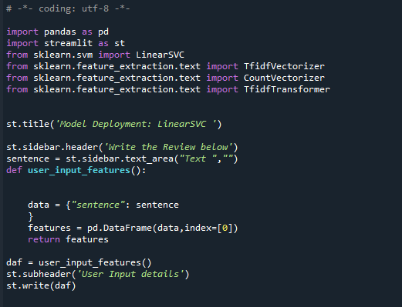
By using STREAMLIT the deployment was done

Slide 22
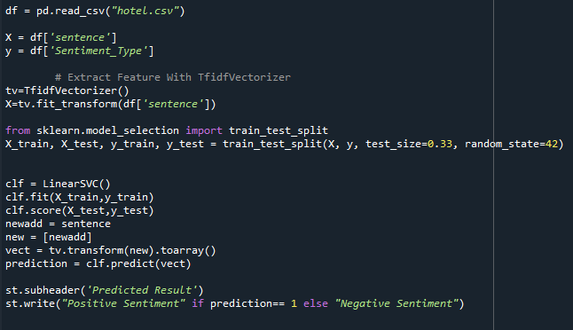
To analyse and display the Sentiment

Slide 23
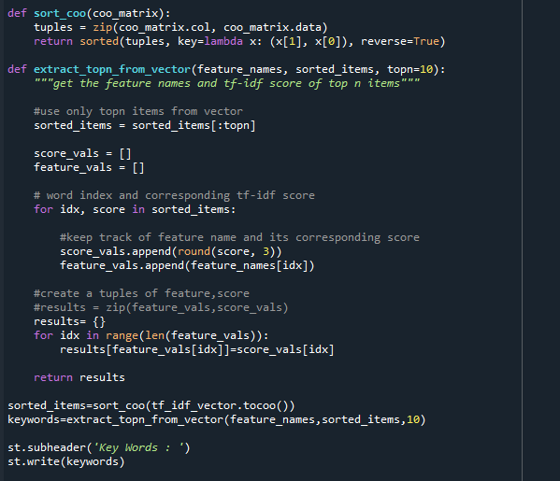
To show the KEYWORDS

Slide 24
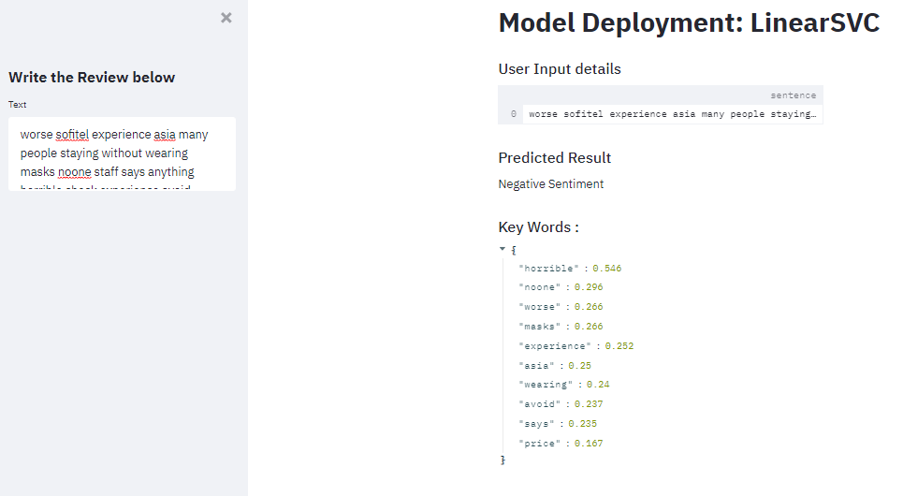
EXAMPLE OF NEGATIVE SENTIMENT

Slide 25
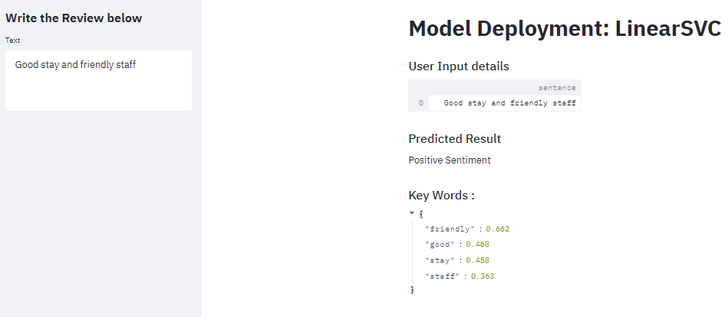
EXAMPLE OF POSITIVE SENTIMENT

Slide 26
Challenges Faced During the Project
The major challenge during the project was from the Deployment Part.
To use Flask or to use Streamlit. To understand their working after a lot of research we were able to make it work with both Flask and Streamlit.
But again, we got stuck in the part to display the keywords during the sentiment analysis. Which again consumed too much time for research and solution.
And Finally we are happy to announce we overcame all the hurdles and today we stand complete.

Slide 27
We would like to thank PARTH Sir for guiding us throughout and our teamates that stood together for the completion of the project. THANK YOU

